Slide 1
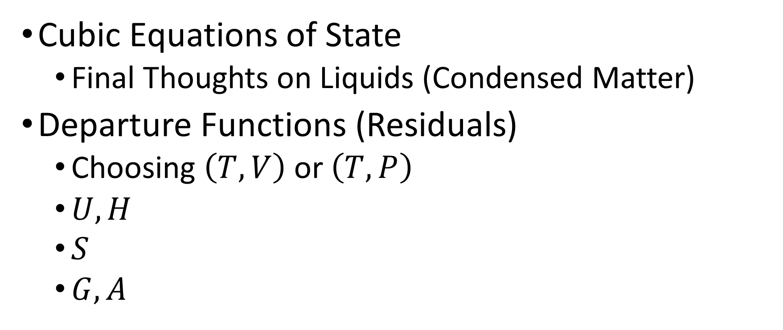
Thursday, November 3
Cubic Equations of State
Final Thoughts on Liquids (Condensed Matter)
Departure Functions (Residuals)
Choosing $\left(T,V\right)$ or $\left(T,P\right)$
$U,H$
$S$
$G,A$

Slide 2
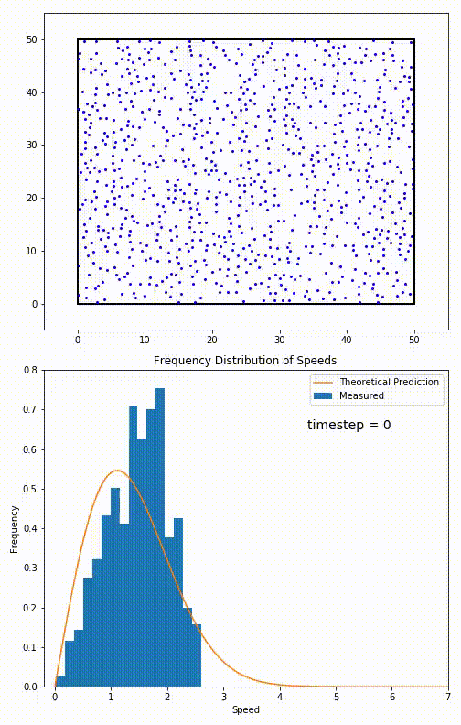
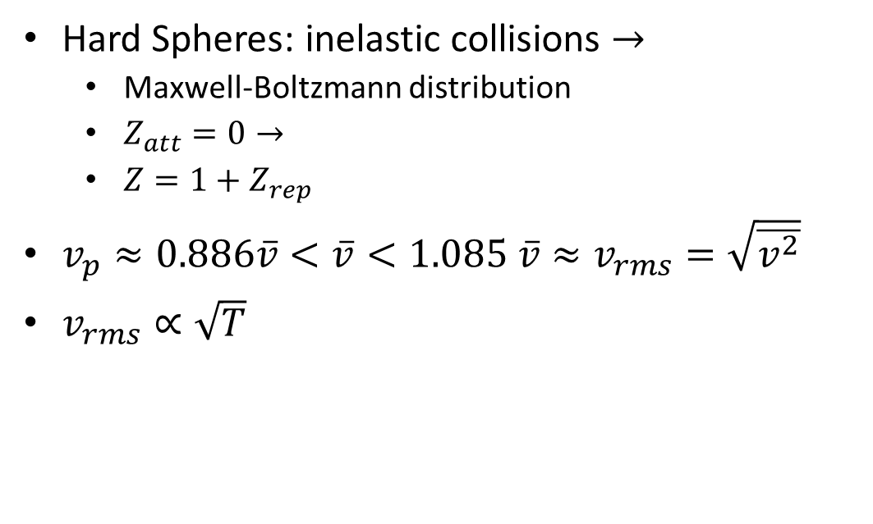
Velocity Distribution: Hard Spheres
Hard Spheres: inelastic collisions $→$
Maxwell-Boltzmann distribution
$Z_{att}=0→$
$Z=1+Z_{rep}$
$v_{p}≈0.886\overline{v}<\overline{v}<1.085 \overline{v}≈v_{rms}=\sqrt{\overline{v^{2}}}$
$v_{rms}∝\sqrt{T}$
Notes:
https://en.wikipedia.org/wiki/Maxwell%E2%80%93Boltzmann_distribution

Slide 3
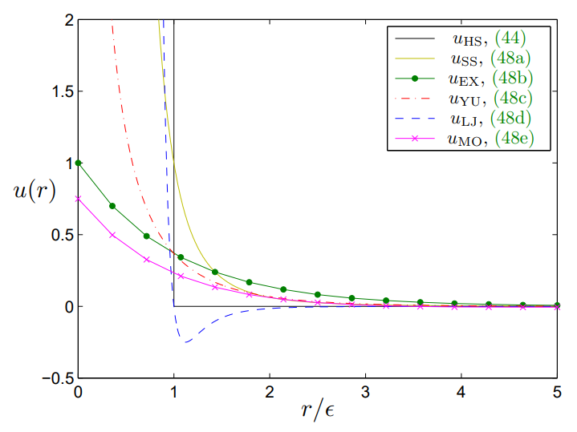
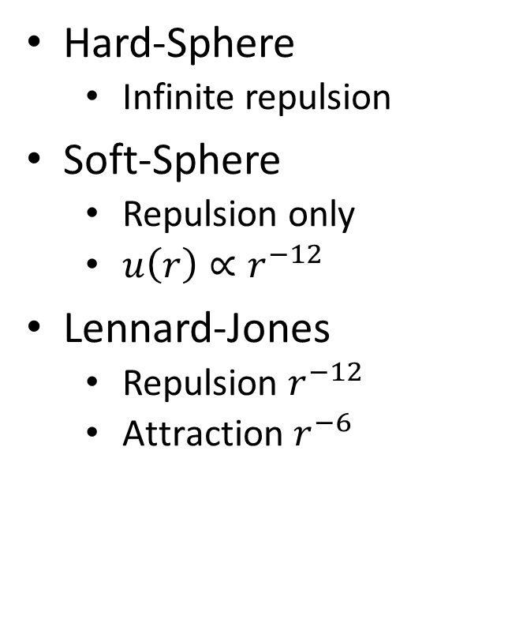
Intermolecular Pair Potentials
Hard-Sphere
Infinite repulsion
Soft-Sphere
Repulsion only
$u\left(r\right)∝r^{−12}$
Lennard-Jones
Repulsion $r^{−12}$
$\text{Attraction} r^{−6}$
Bruna, Maria & Chapman, Stephen & Robinson, Martin. (2017). Diffusion of Particles with Short-Range Interactions. SIAM Journal on Applied Mathematics. 77. 10.1137/17M1118543.

Slide 4
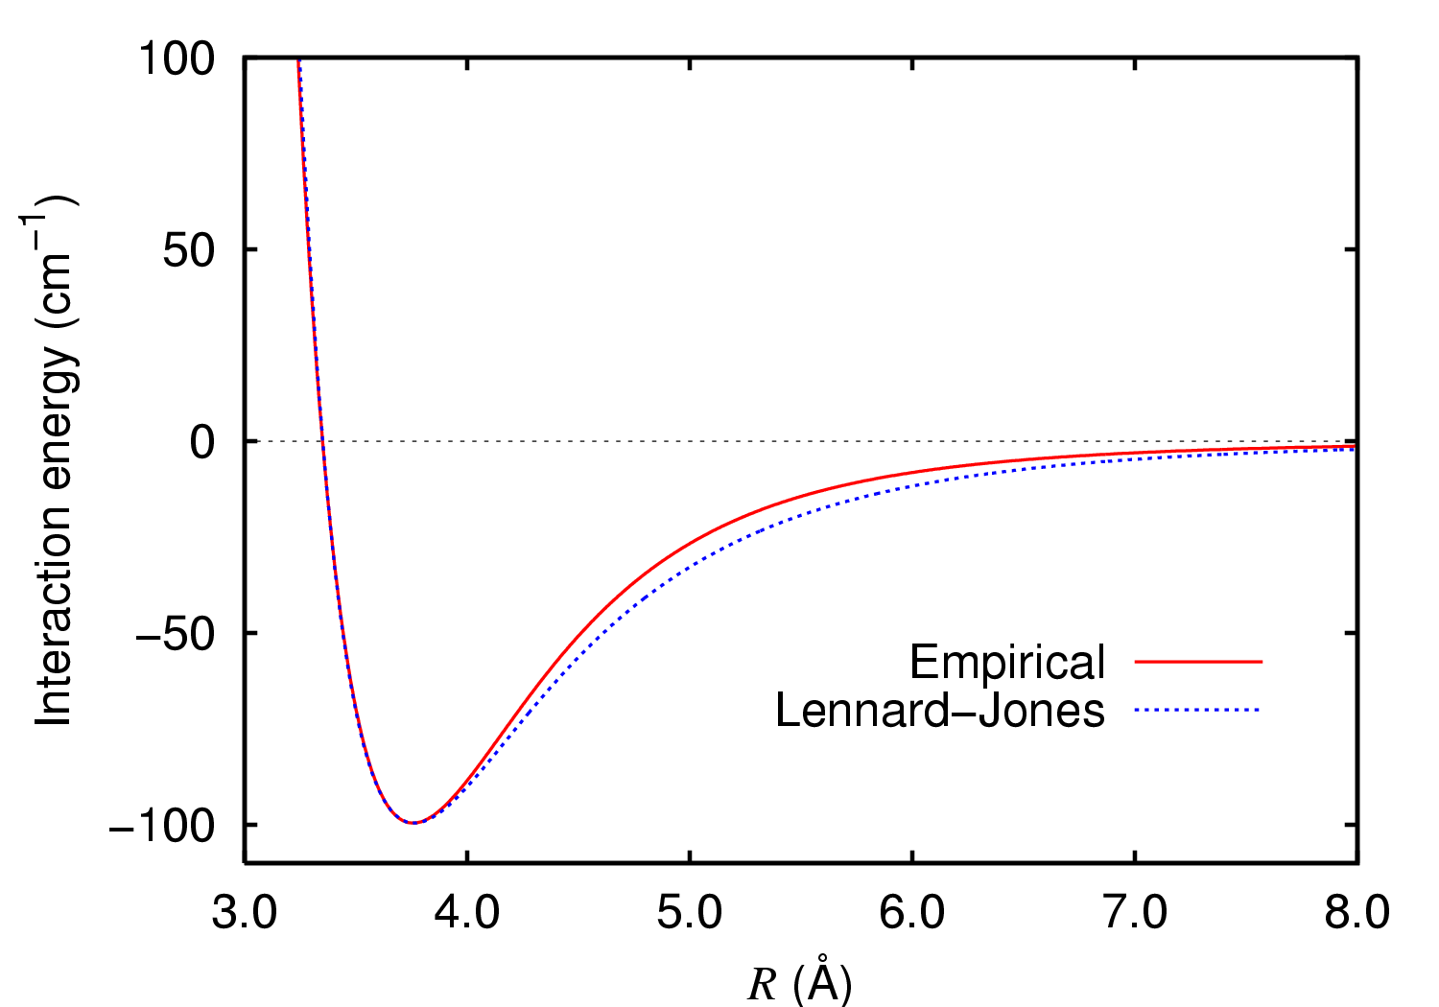
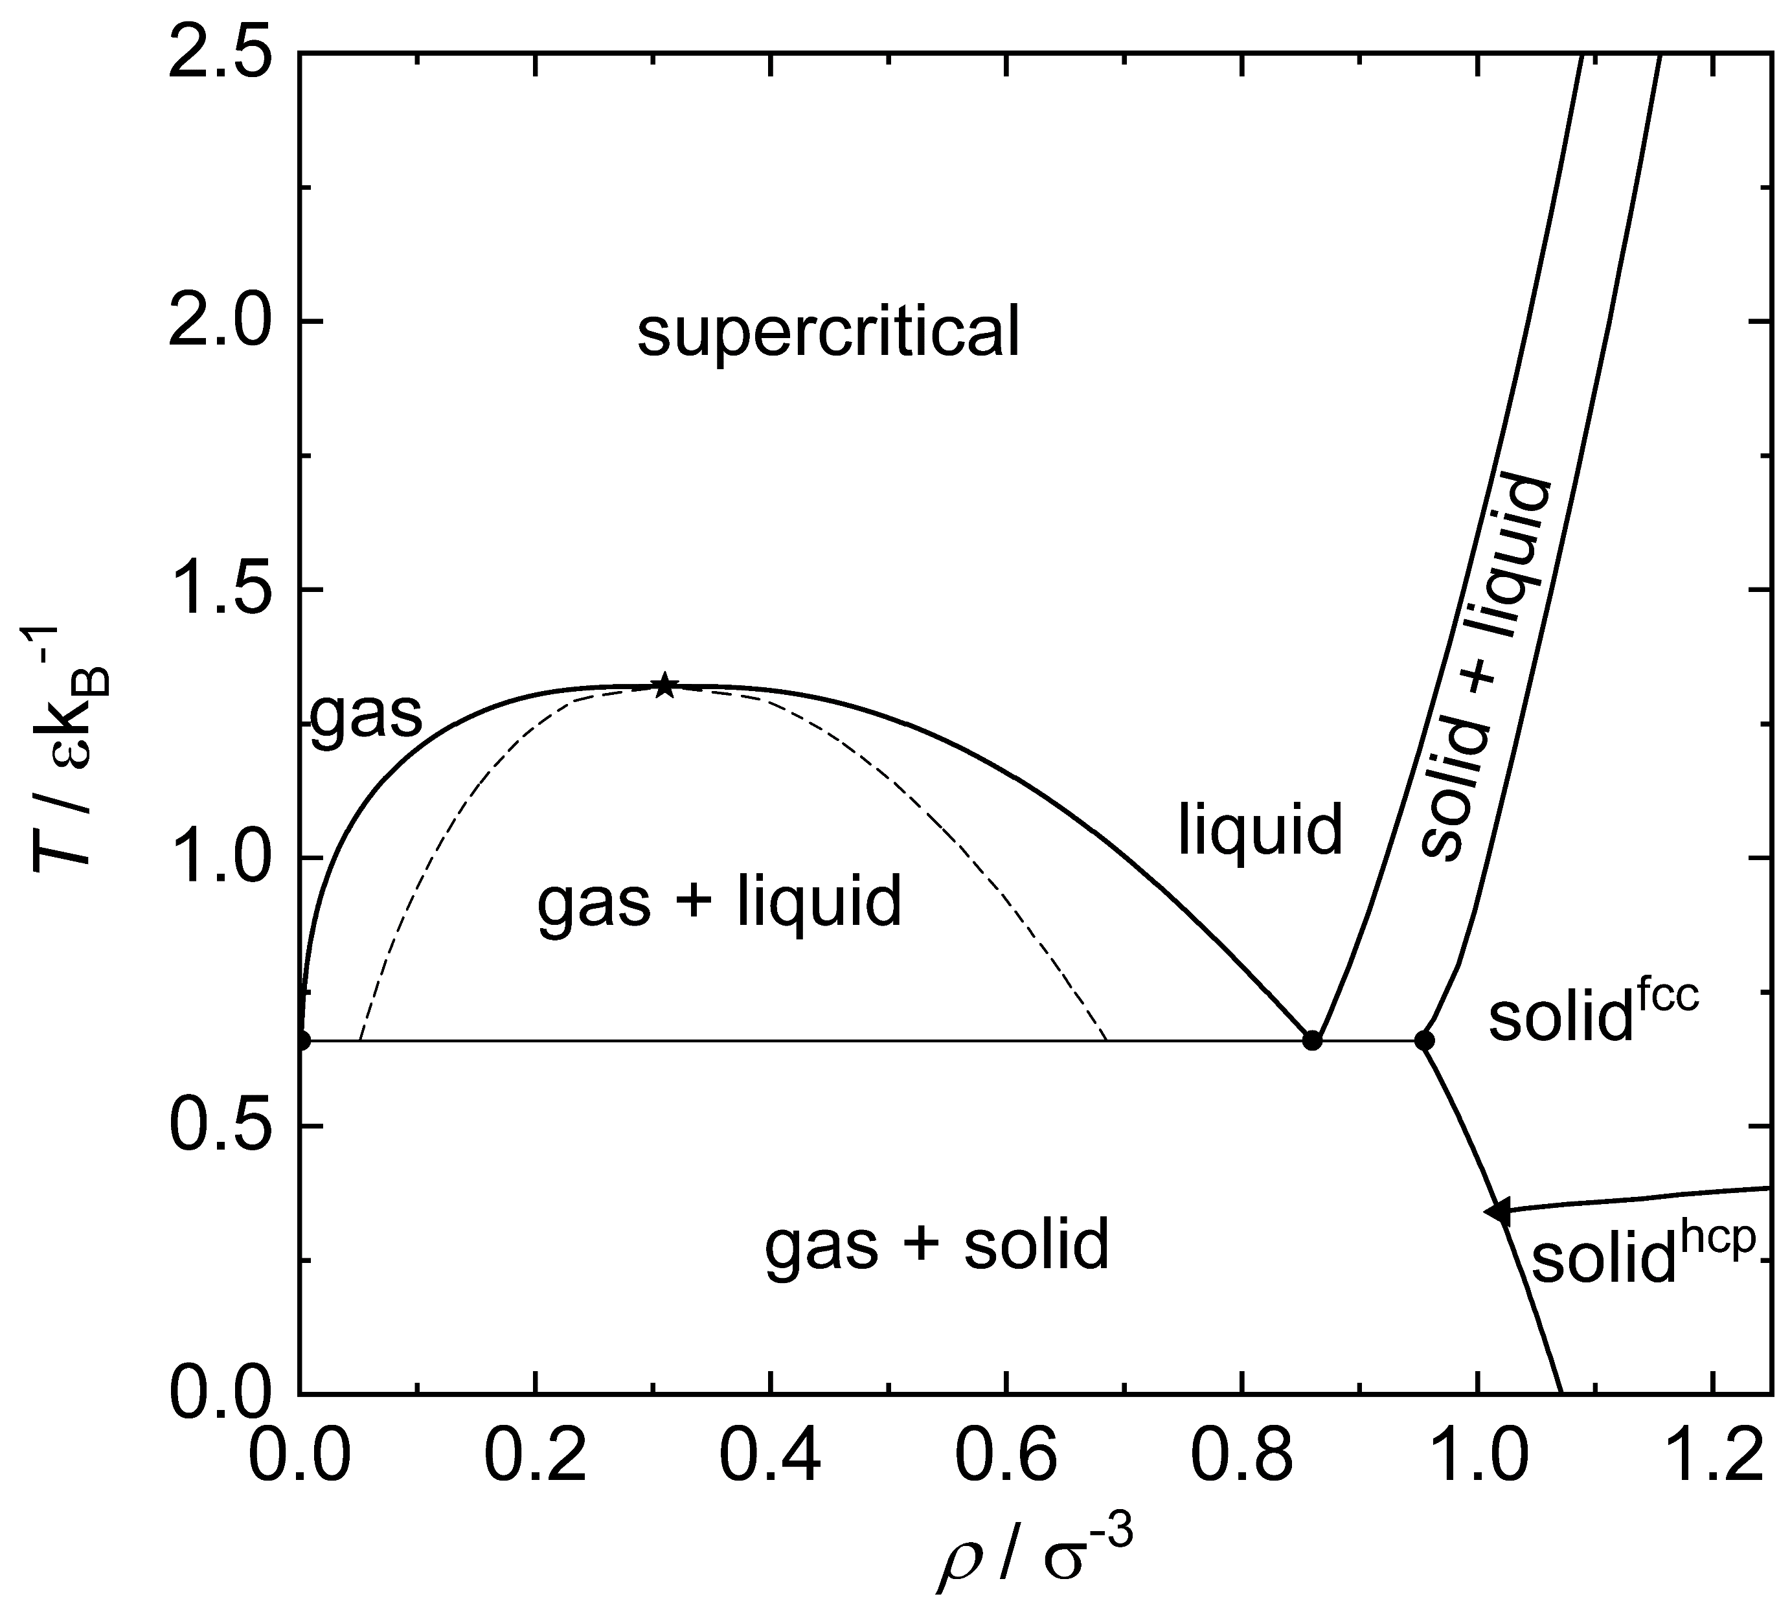
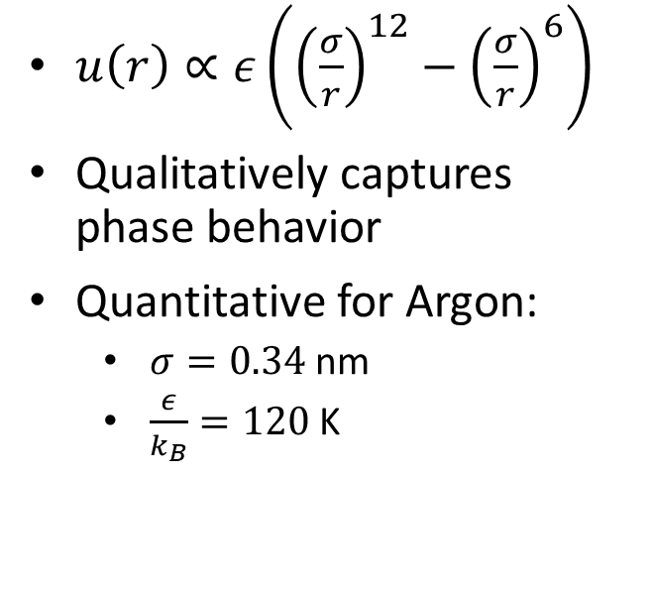
Lennard-Jones Phase Diagram
$u\left(r\right)∝ε\left({\left(\frac{σ}{r}\right)}^{12}−{\left(\frac{σ}{r}\right)}^{6}\right)$
Qualitatively captures phase behavior
Quantitative for Argon:
$σ=0.34$ nm
$\frac{ε}{k_{B}}=120$ K
Notes:
https://en.wikipedia.org/wiki/Lennard-Jones_potential
https://commons.wikimedia.org/wiki/File:Argon_dimer_potential_and_Lennard-Jones.png

Slide 5
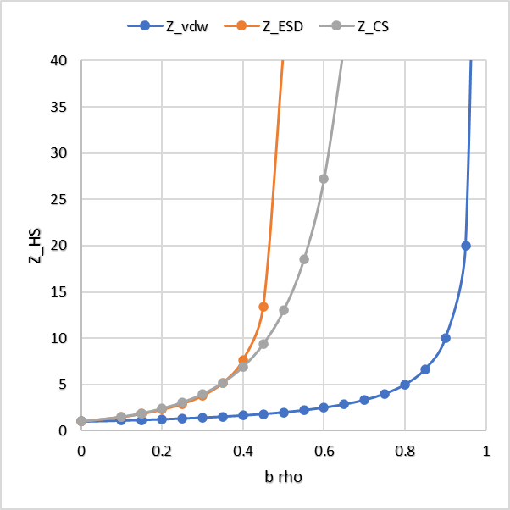
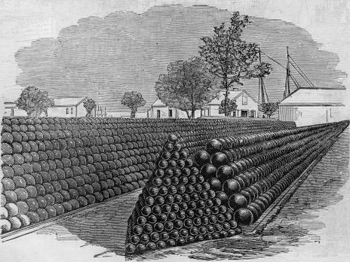
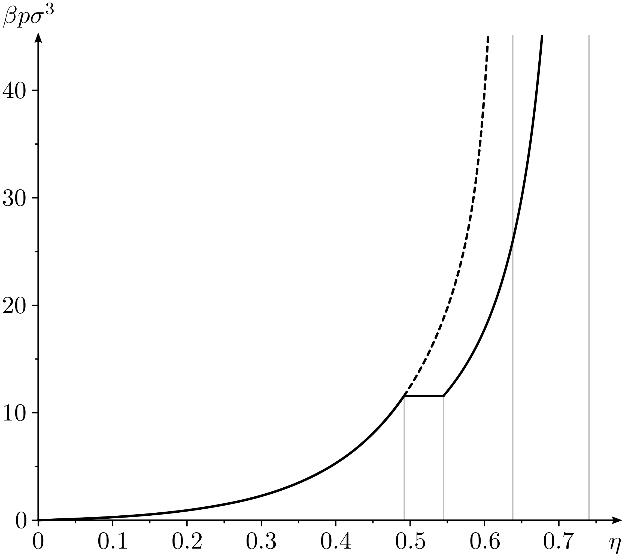
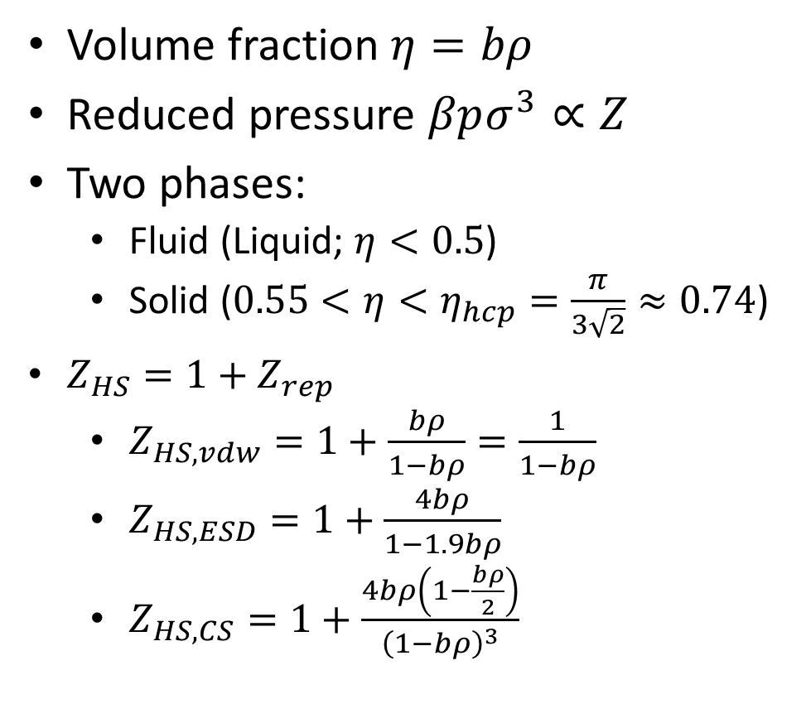
Hard Spheres: van der Waals (and others)
https://upload.wikimedia.org/wikipedia/commons/e/e2/Fortres_Monroe_1861_-_Cannon-balls.jpg
Volume fraction $η=bρ$
Reduced pressure $βpσ^{3}∝Z$
Two phases:
Fluid (Liquid; $η<0.5$)
Solid ($0.55<η<η_{hcp}=\frac{π}{3\sqrt{2}}≈0.74$)
$Z_{HS}=1+Z_{rep}$
$Z_{HS,vdw}=1+\frac{bρ}{1−bρ}=\frac{1}{1−bρ}$
$Z_{HS,ESD}=1+\frac{4bρ}{1−1.9bρ}$
$Z_{HS,CS}=1+\frac{4bρ\left(1−\frac{bρ}{2}\right)}{{\left(1−bρ\right)}^{3}}$
Notes:
https://en.wikipedia.org/wiki/Hard_spheres
Phase diagram of hard sphere system (Solid line - stable branch, dashed line - metastable branch): Reduced pressure as a function of the volume fraction (or packing fraction)

Slide 6
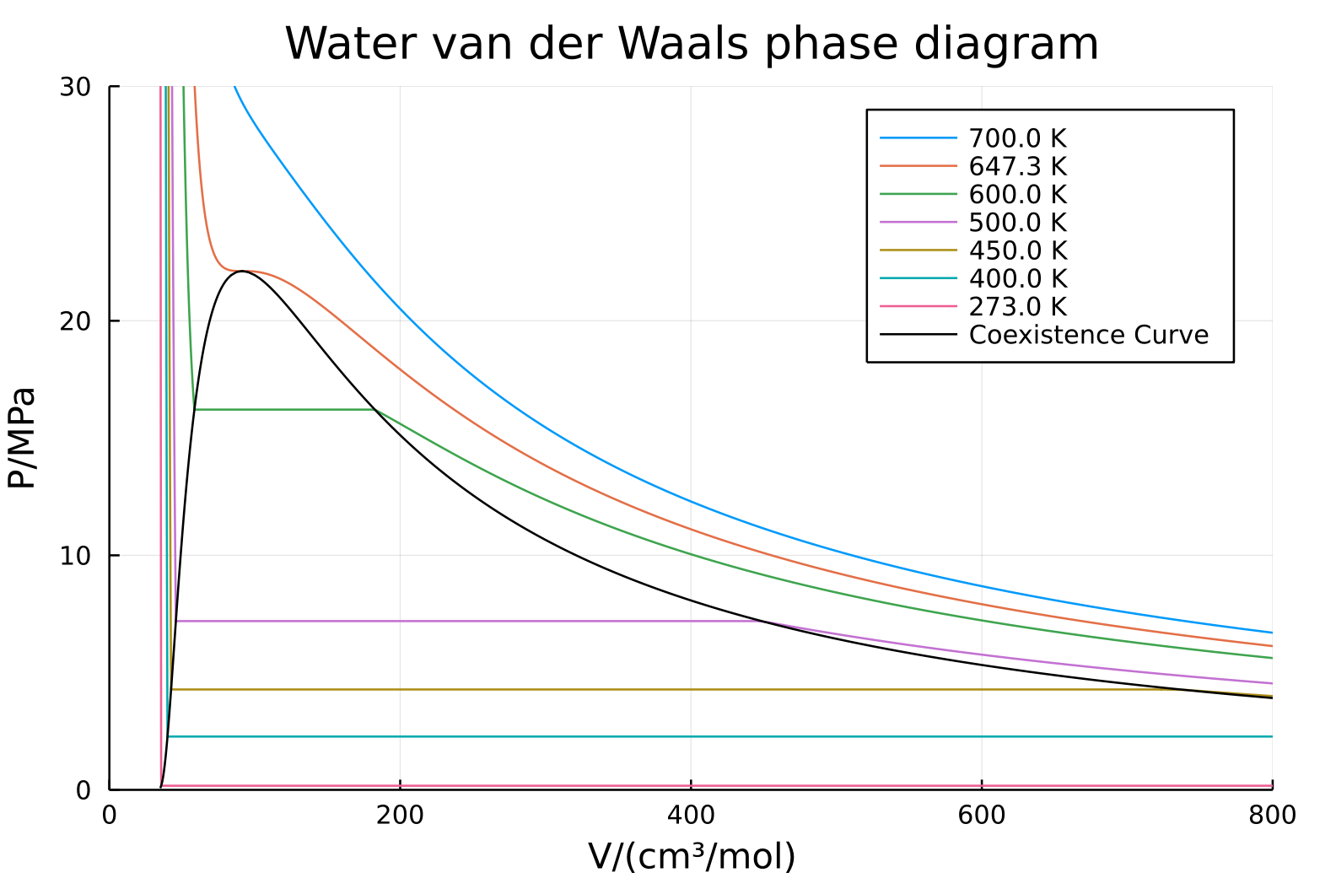
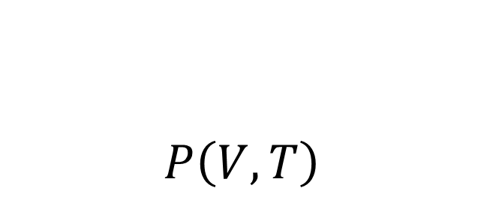
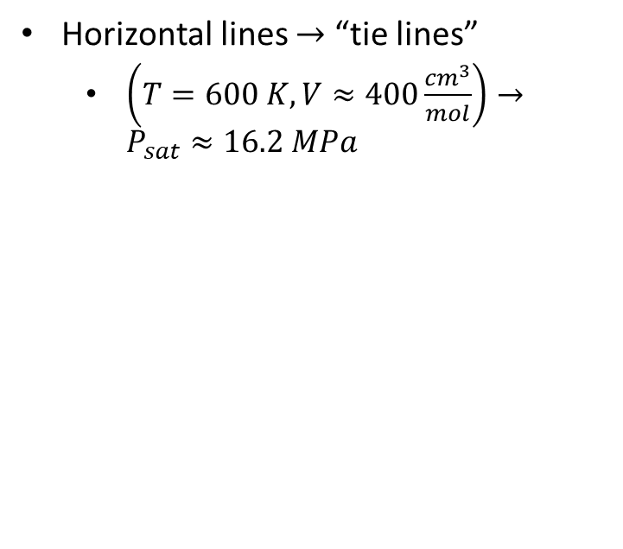
$$P\left(V,T\right)$$
Horizontal lines $→$ “tie lines”
$\left(T=600 K,V≈400\frac{cm^{3}}{mol}\right)→P_{sat}≈16.2 MPa$

Slide 7
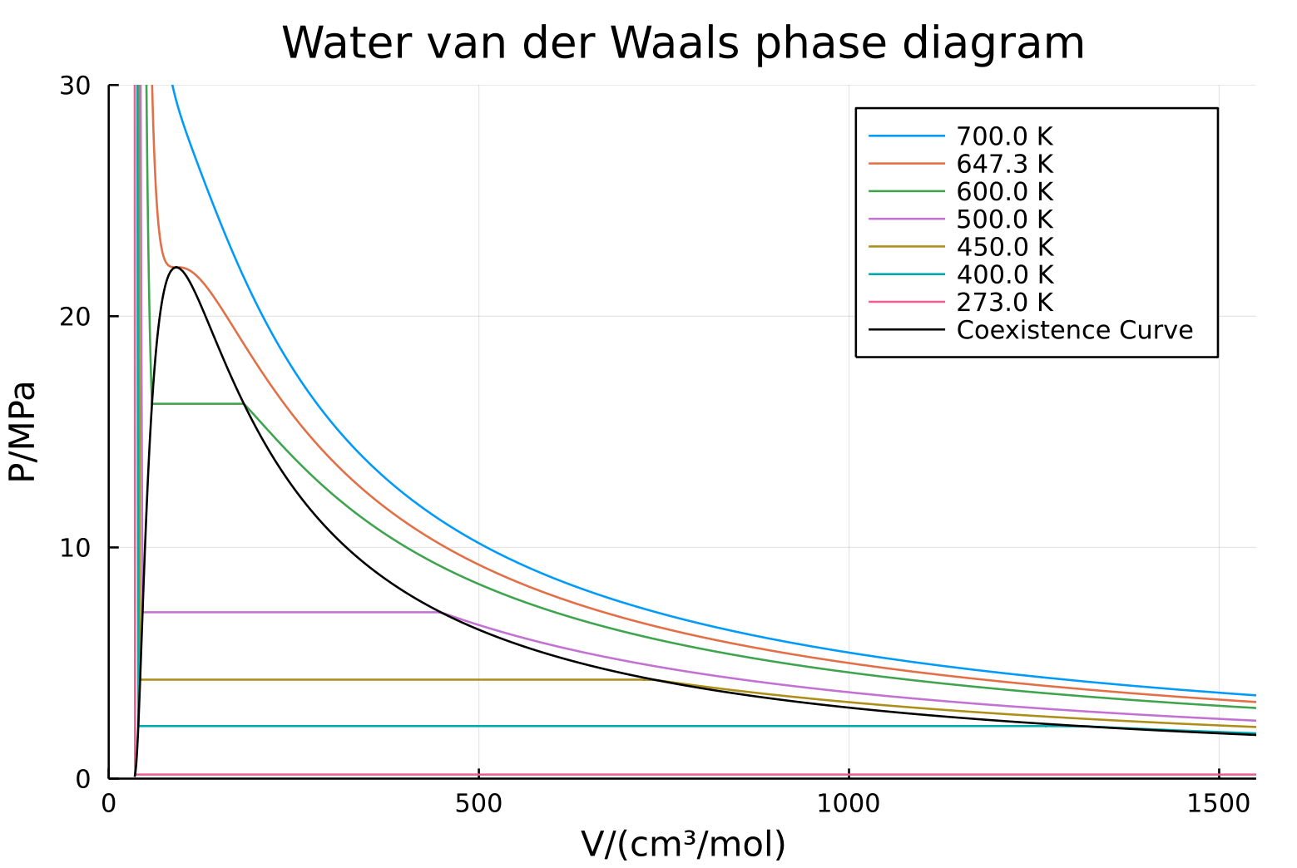

$$P_{sat}\left(T=400 K\right)≈2.3 MPa$$

Slide 8
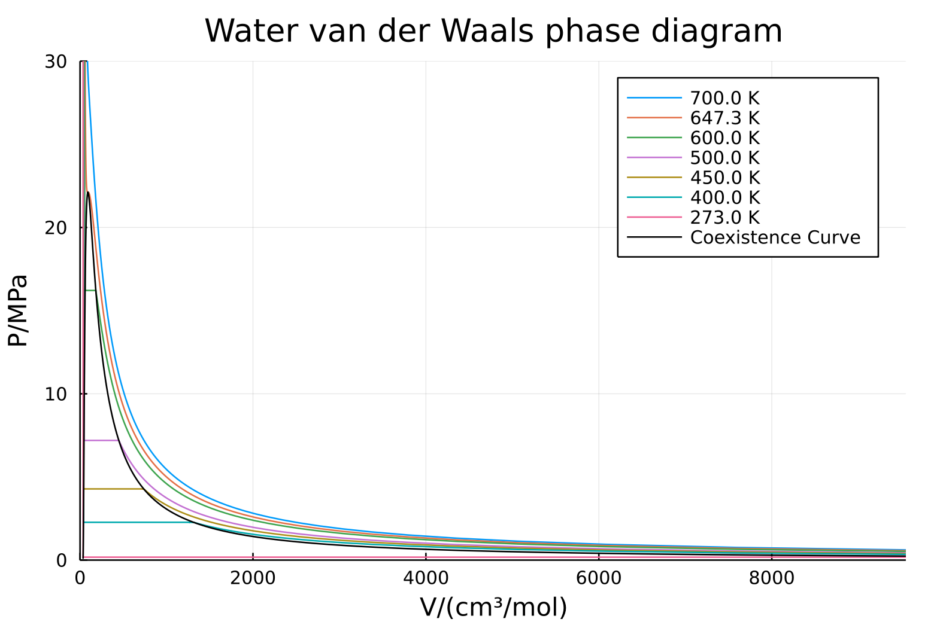
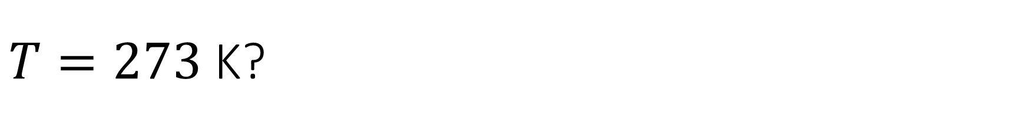
$T=273$ K?

Slide 9
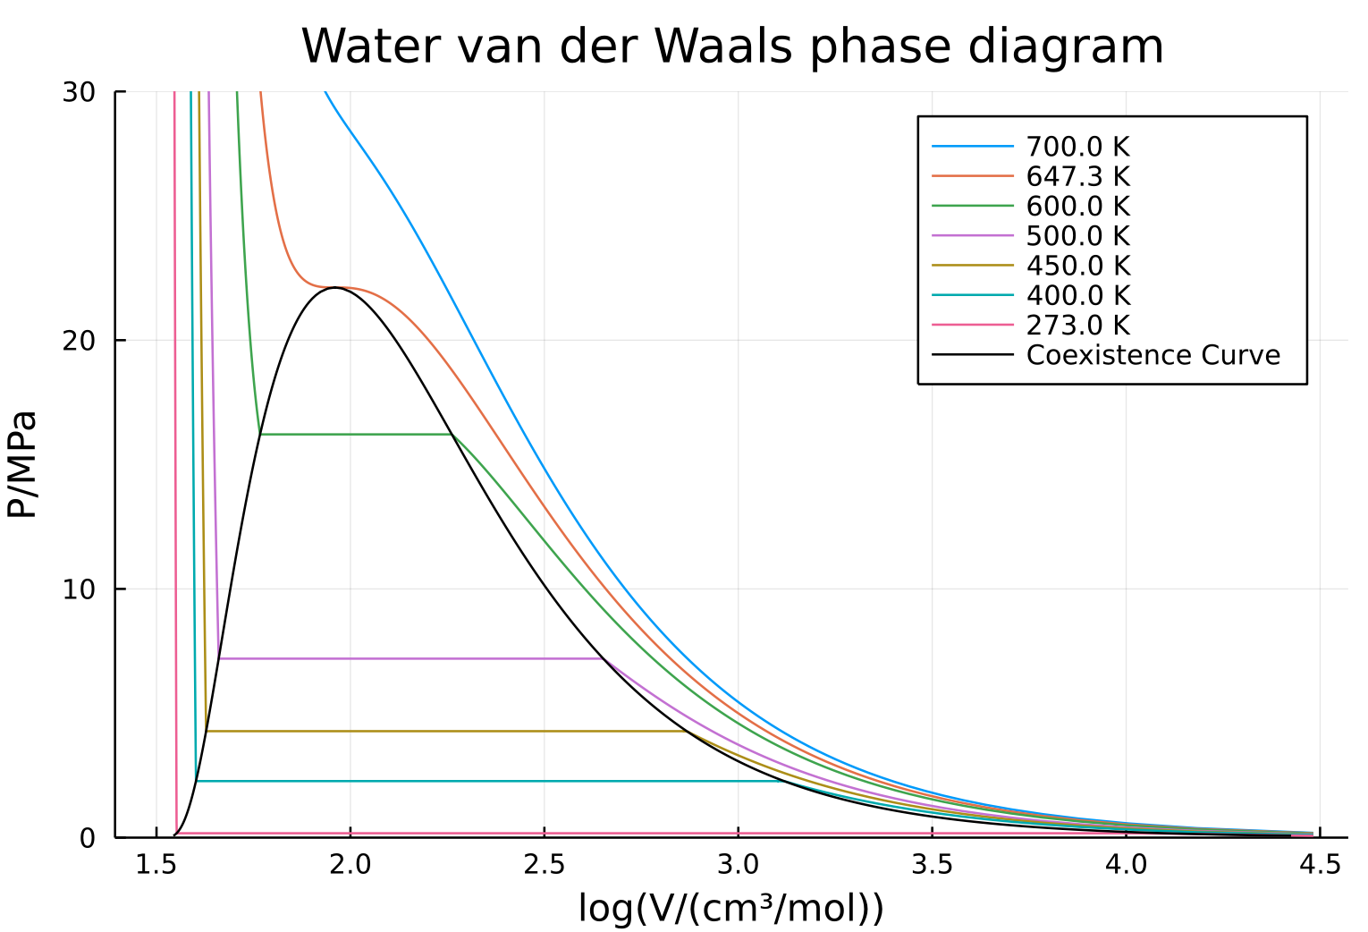
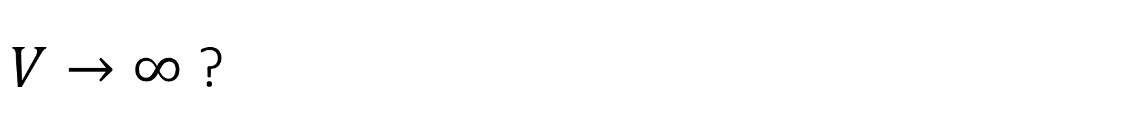
$V→∞$ ?

Slide 10
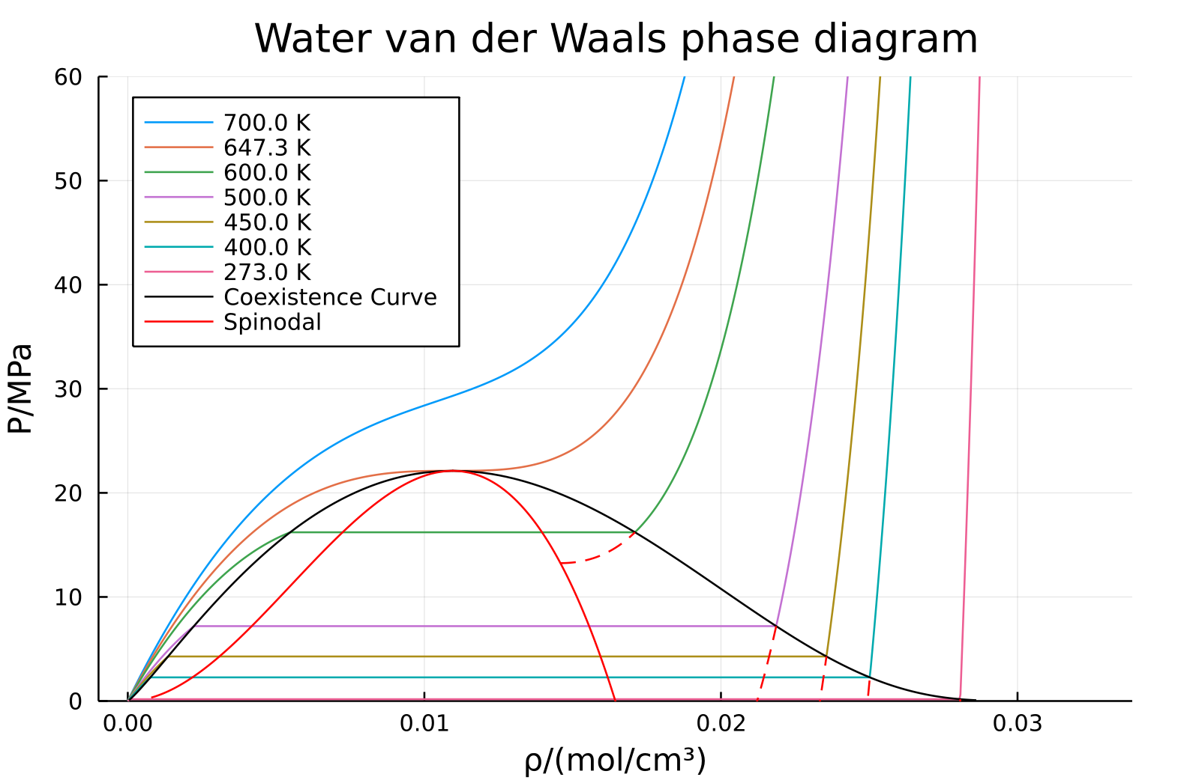

$$P\left(\frac{1}{V}\right)=P\left(ρ\right)$$

Slide 11
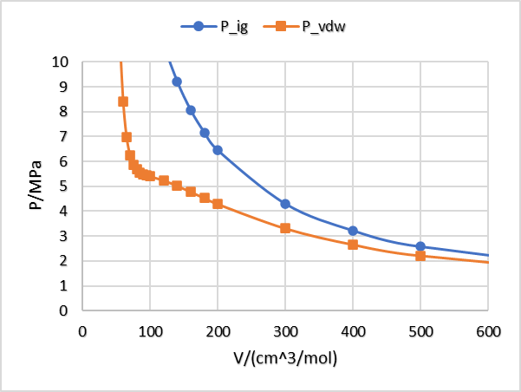
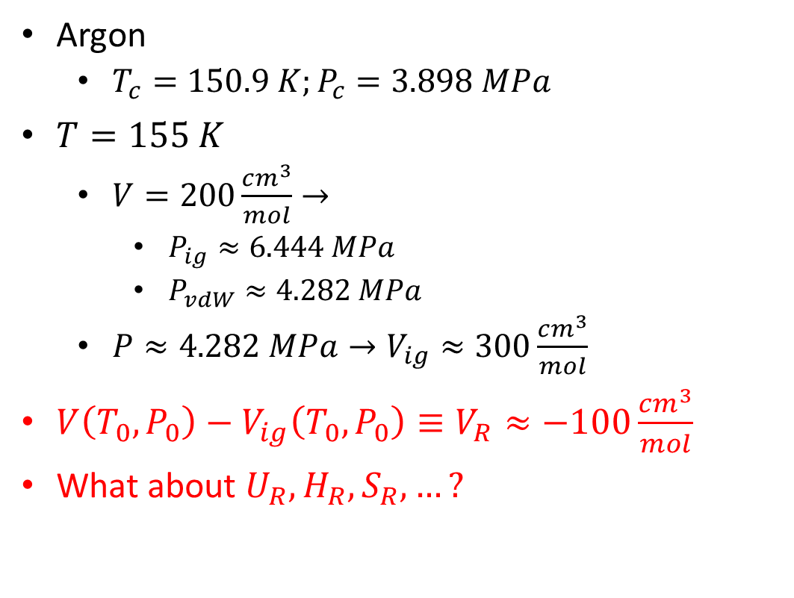
Pressure and Volume Differences: Residuals
Argon
$T_{c}=150.9 K;P_{c}=3.898 MPa$
$T=155 K$
$V=200\frac{cm^{3}}{mol}→$
$P_{ig}≈6.444 MPa$
$P_{vdW}≈4.282 MPa$
$P≈4.282 MPa→V_{ig}≈300\frac{cm^{3}}{mol}$
$V\left(T_{0},P_{0}\right)−V_{ig}\left(T_{0},P_{0}\right)≡V_{R}≈−100\frac{cm^{3}}{mol}$
What about $U_{R},H_{R},S_{R},…?$

Slide 12
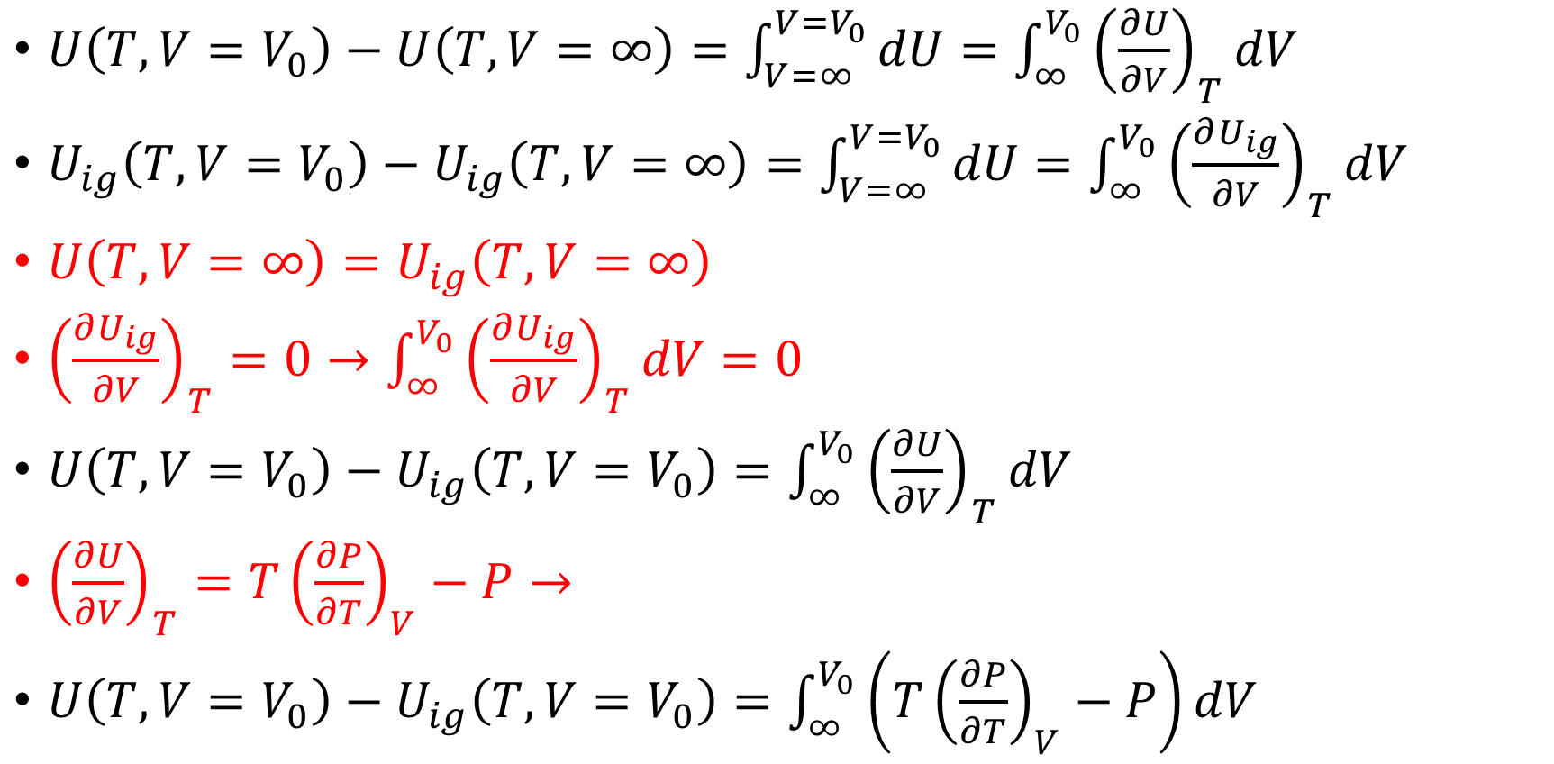
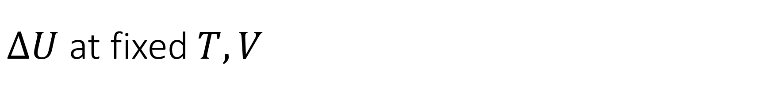
$ΔU$ at fixed $T,V$
$U\left(T,V=V_{0}\right)−U\left(T,V=∞\right)=\int_{V=∞}^{V=V_{0}}{dU}=\int_{∞}^{V_{0}}{{\left(\frac{∂U}{∂V}\right)}_{T}dV}$
$U_{ig}\left(T,V=V_{0}\right)−U_{ig}\left(T,V=∞\right)=\int_{V=∞}^{V=V_{0}}{dU}=\int_{∞}^{V_{0}}{{\left(\frac{∂U_{ig}}{∂V}\right)}_{T}dV}$
$U\left(T,V=∞\right)=U_{ig}\left(T,V=∞\right)$
${\left(\frac{∂U_{ig}}{∂V}\right)}_{T}=0→\int_{∞}^{V_{0}}{{\left(\frac{∂U_{ig}}{∂V}\right)}_{T}dV}=0$
$U\left(T,V=V_{0}\right)−U_{ig}\left(T,V=V_{0}\right)=\int_{∞}^{V_{0}}{{\left(\frac{∂U}{∂V}\right)}_{T}dV}$
${\left(\frac{∂U}{∂V}\right)}_{T}=T{\left(\frac{∂P}{∂T}\right)}_{V}−P→$
$U\left(T,V=V_{0}\right)−U_{ig}\left(T,V=V_{0}\right)=\int_{∞}^{V_{0}}{\left(T{\left(\frac{∂P}{∂T}\right)}_{V}−P\right)dV}$

Slide 13
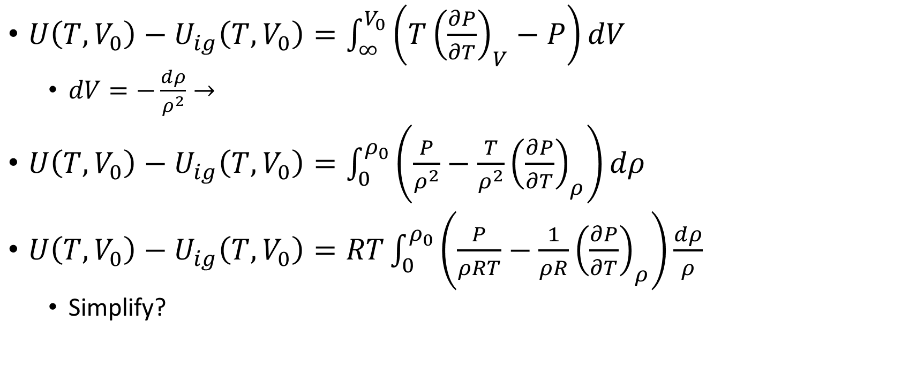

$$V=∞→ρ=0$$
$U\left(T,V_{0}\right)−U_{ig}\left(T,V_{0}\right)=\int_{∞}^{V_{0}}{\left(T{\left(\frac{∂P}{∂T}\right)}_{V}−P\right)dV}$
$dV=−\frac{dρ}{ρ^{2}}→$
$U\left(T,V_{0}\right)−U_{ig}\left(T,V_{0}\right)=\int_{0}^{ρ_{0}}{\left(\frac{P}{ρ^{2}}−\frac{T}{ρ^{2}}{\left(\frac{∂P}{∂T}\right)}_{ρ}\right)dρ}$
$U\left(T,V_{0}\right)−U_{ig}\left(T,V_{0}\right)=RT\int_{0}^{ρ_{0}}{\left(\frac{P}{ρRT}−\frac{1}{ρR}{\left(\frac{∂P}{∂T}\right)}_{ρ}\right)\frac{dρ}{ρ}}$
Simplify?

Slide 14
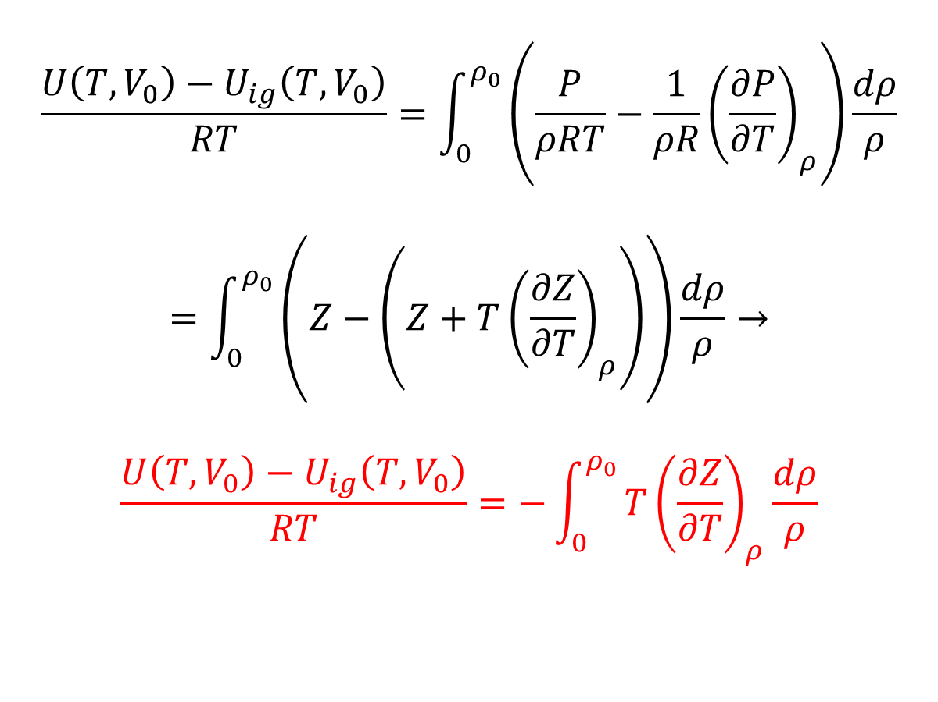
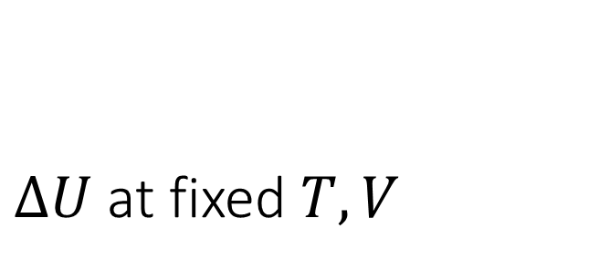
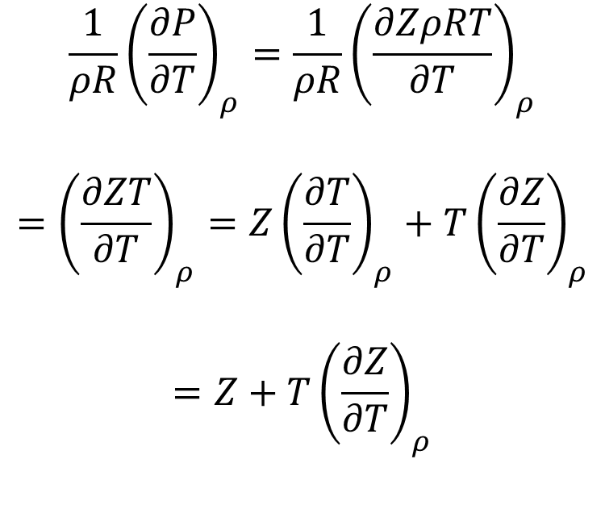
$ΔU$ at fixed $T,V$
$$\frac{U\left(T,V_{0}\right)−U_{ig}\left(T,V_{0}\right)}{RT}=\int_{0}^{ρ_{0}}{\left(\frac{P}{ρRT}−\frac{1}{ρR}{\left(\frac{∂P}{∂T}\right)}_{ρ}\right)\frac{dρ}{ρ}}$$
$$=\int_{0}^{ρ_{0}}{\left(Z−\left(Z+T{\left(\frac{∂Z}{∂T}\right)}_{ρ}\right)\right)\frac{dρ}{ρ}}→$$
$$\frac{U\left(T,V_{0}\right)−U_{ig}\left(T,V_{0}\right)}{RT}=−\int_{0}^{ρ_{0}}{T{\left(\frac{∂Z}{∂T}\right)}_{ρ}\frac{dρ}{ρ}}$$
$$\frac{1}{ρR}{\left(\frac{∂P}{∂T}\right)}_{ρ}=\frac{1}{ρR}{\left(\frac{∂ZρRT}{∂T}\right)}_{ρ}$$
$$={\left(\frac{∂ZT}{∂T}\right)}_{ρ}={Z\left(\frac{∂T}{∂T}\right)}_{ρ}+T{\left(\frac{∂Z}{∂T}\right)}_{ρ}$$
$$=Z+T{\left(\frac{∂Z}{∂T}\right)}_{ρ}$$

Slide 15
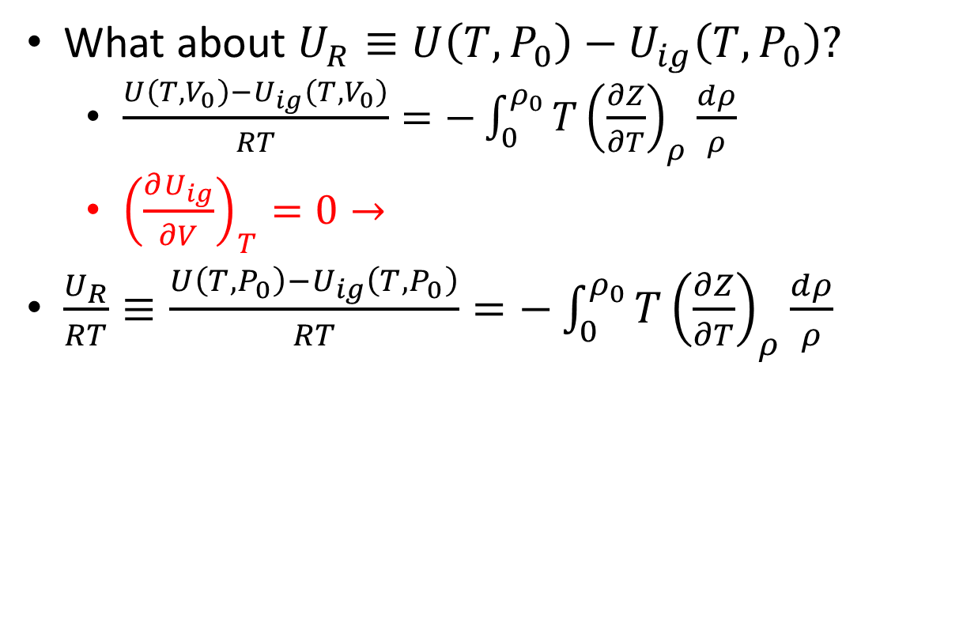
Internal Energy Departures
What about $U_{R}≡U\left(T,P_{0}\right)−U_{ig}\left(T,P_{0}\right)?$
$\frac{U\left(T,V_{0}\right)−U_{ig}\left(T,V_{0}\right)}{RT}=−\int_{0}^{ρ_{0}}{T{\left(\frac{∂Z}{∂T}\right)}_{ρ}\frac{dρ}{ρ}}$
${\left(\frac{∂U_{ig}}{∂V}\right)}_{T}=0→$
$\frac{U_{R}}{RT}≡\frac{U\left(T,P_{0}\right)−U_{ig}\left(T,P_{0}\right)}{RT}=−\int_{0}^{ρ_{0}}{T{\left(\frac{∂Z}{∂T}\right)}_{ρ}\frac{dρ}{ρ}}$
Notes:
If extra time, can show enthalpy departure quickly

Slide 16
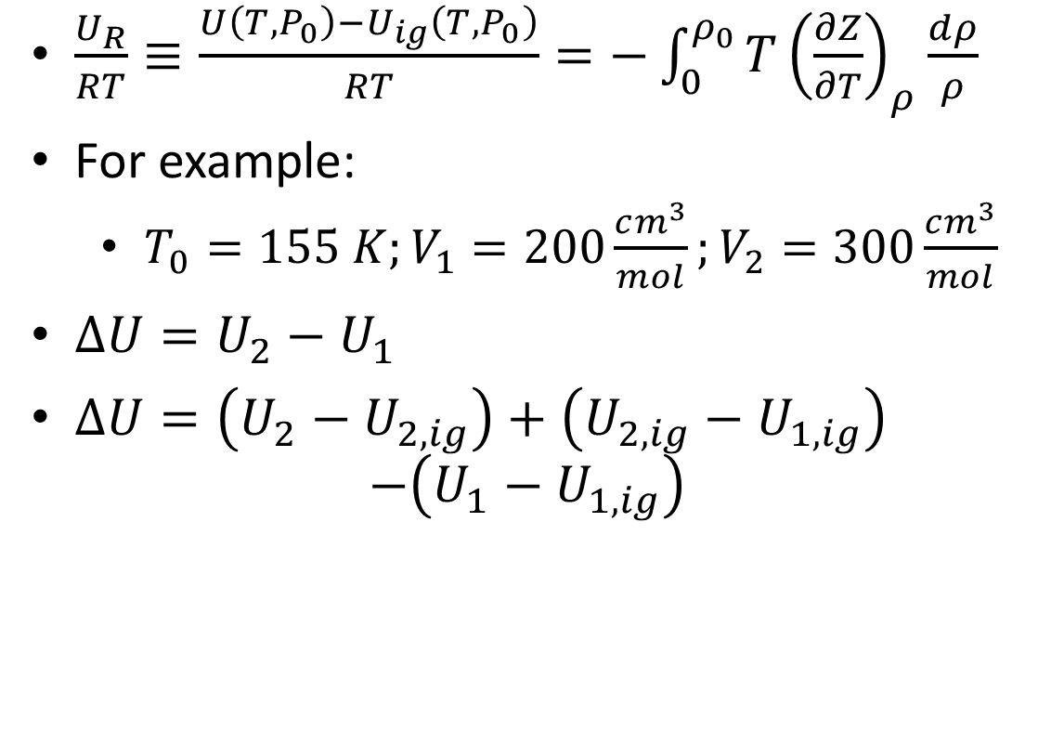
Why Use a Departure?
$\frac{U_{R}}{RT}≡\frac{U\left(T,P_{0}\right)−U_{ig}\left(T,P_{0}\right)}{RT}=−\int_{0}^{ρ_{0}}{T{\left(\frac{∂Z}{∂T}\right)}_{ρ}\frac{dρ}{ρ}}$
For example:
$T_{0}=155 K;V_{1}=200\frac{cm^{3}}{mol};V_{2}=300\frac{cm^{3}}{mol}$
$ΔU=U_{2}−U_{1}$
$ΔU=\left(U_{2}−U_{2,ig}\right)+\left(U_{2,ig}−U_{1,ig}\right)$ $−\left(U_{1}−U_{1,ig}\right)$
Notes:
If extra time, can show enthalpy departure quickly

Slide 17
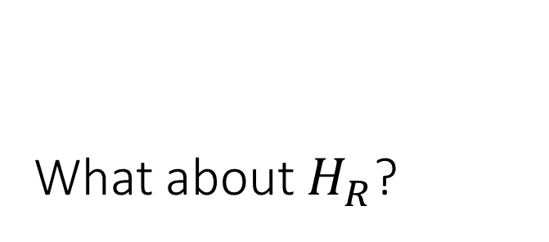
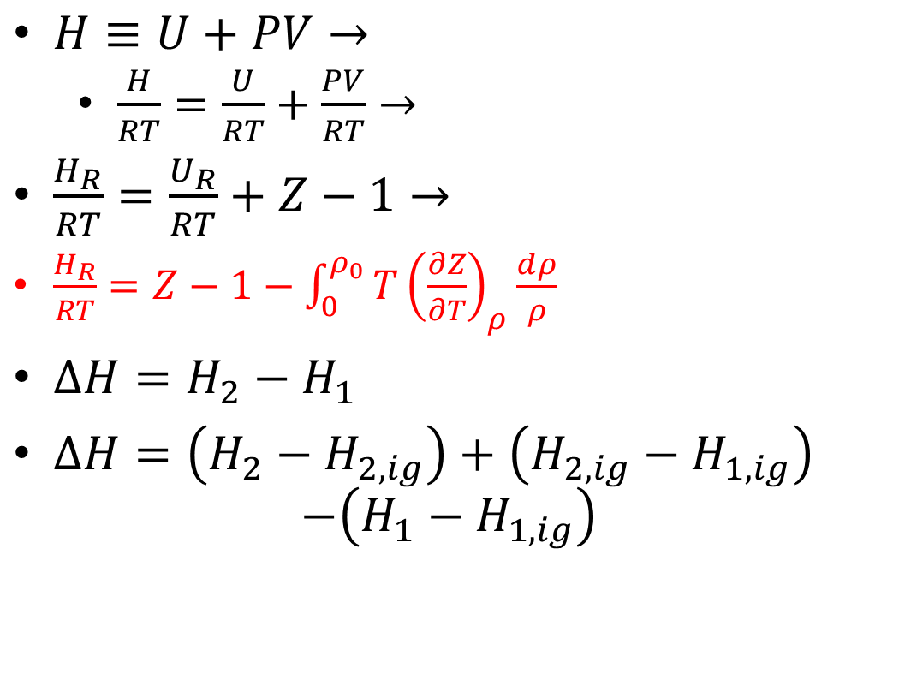
What about $H_{R}$?
$H≡U+PV→$
$\frac{H}{RT}=\frac{U}{RT}+\frac{PV}{RT}→$
$\frac{H_{R}}{RT}=\frac{U_{R}}{RT}+Z−1→$
$\frac{H_{R}}{RT}=Z−1−\int_{0}^{ρ_{0}}{T{\left(\frac{∂Z}{∂T}\right)}_{ρ}\frac{dρ}{ρ}}$
$ΔH=H_{2}−H_{1}$
$ΔH=\left(H_{2}−H_{2,ig}\right)+\left(H_{2,ig}−H_{1,ig}\right)$ $−\left(H_{1}−H_{1,ig}\right)$
Notes:
Can do an example with linear virial, vdW, PR (use PREOS), …

